Slide 1


Machine Learning & Data Analysis
Build AND USE a CNN TO CLASSIFY DIGITS SOUND
Mirko Gualducci

Slide 2
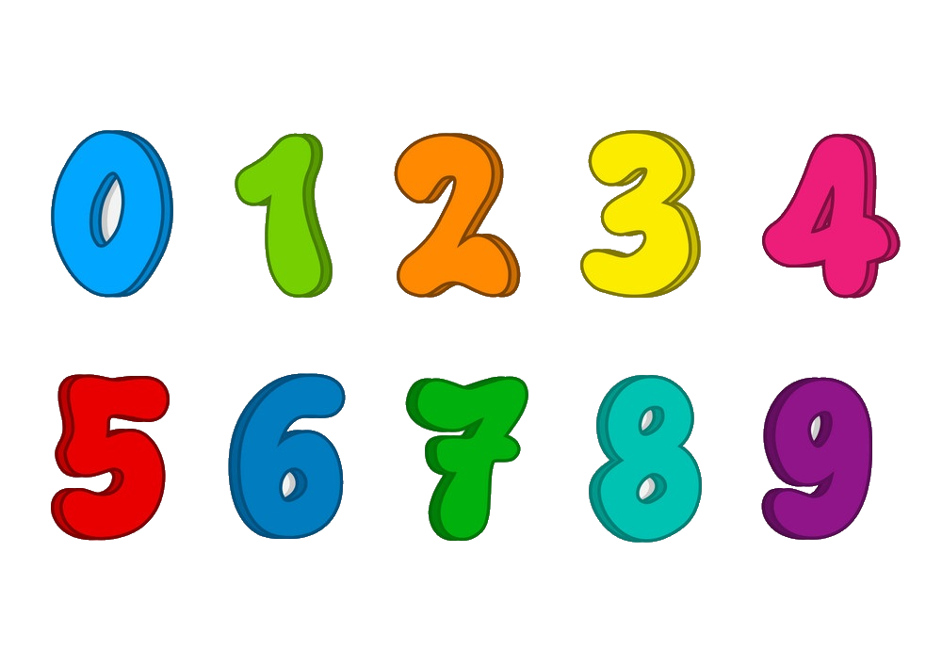

Purpose of my project
Creation of sound utils to modify a sound content and to product own spectrogram.
Built a Convolutional Neural Network to recognize numbers by their vocal pronunciation.
Use the model to predict new digit sounds.

Slide 3




Organization of project
Python code (Google Colab & Jupiter Notebook)
‘sound_utils.ipynb’
‘digits_speach_model.ipynb’
‘digits_speach_record.ipynb’
Kaggle sound dataset
https://www.kaggle.com/datasets/sripaadsrinivasan/audio-mnist
60 folders x 10 numbers x 50 sounds = 60000 sounds

Slide 4
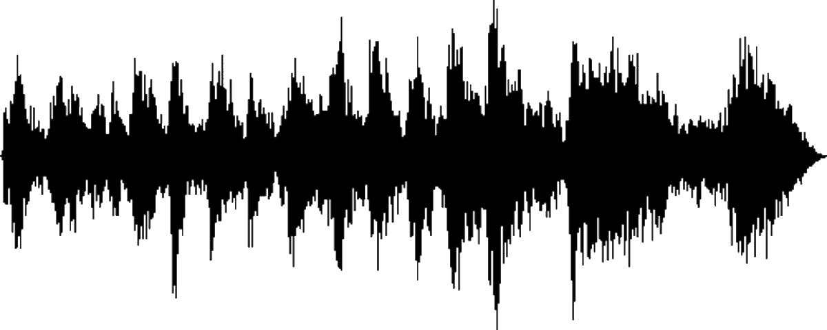
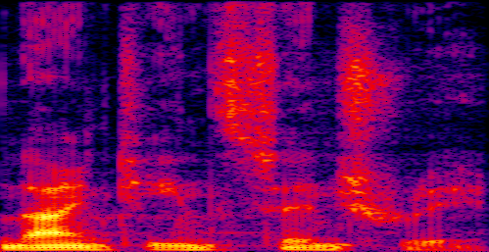

Scheme of the model
Sound waveform
Spectrogram
CNN Architecture
0
[0.011]
1
[0.943]
2
[0.018]
9
[0.005]
Linear classifier
Feature map

Slide 5
Sound Utils – Audio preprocessing (1)
torch + torchaudio
«Open» → load sound from file (wav)
«Rechannel» → convert to input number channel (1 channel mono, 2 channels stereo)
«Resample» → resample the audio (standardize + convert to 48kHz or 44.1kHz)
«Pad or truncate» → redimension of signal to input ms
«Time shift» → shift signal left or right of percentage
«Spectrogram» → convertion of audio to spectrogram (audio feature)
«Data augmentation» → frequency mask (horiz bars) + time mask (vert bars)

Slide 6
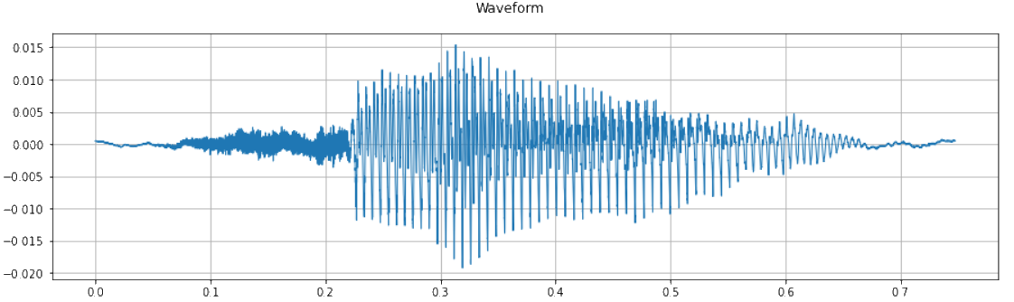
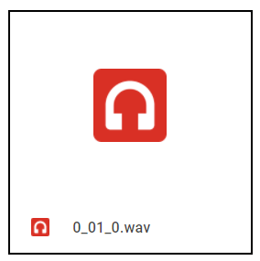
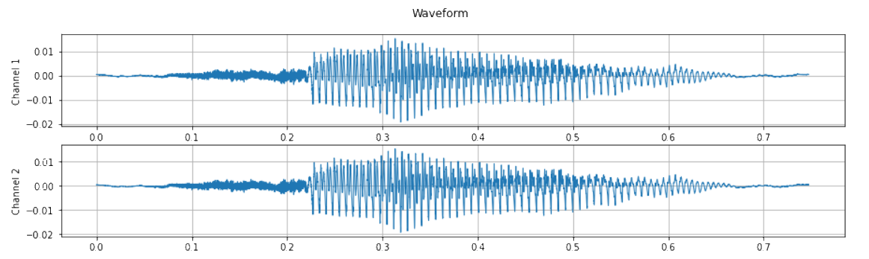
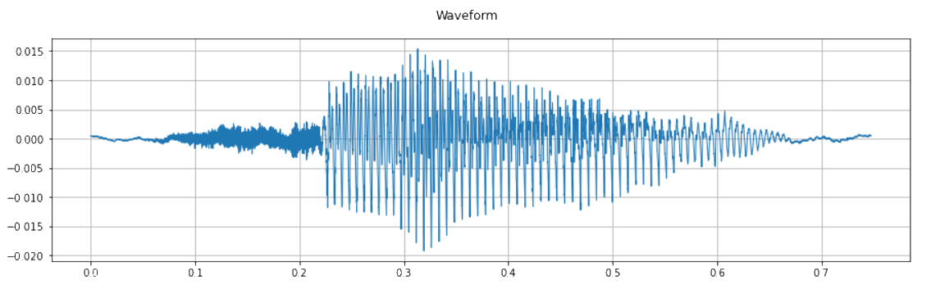
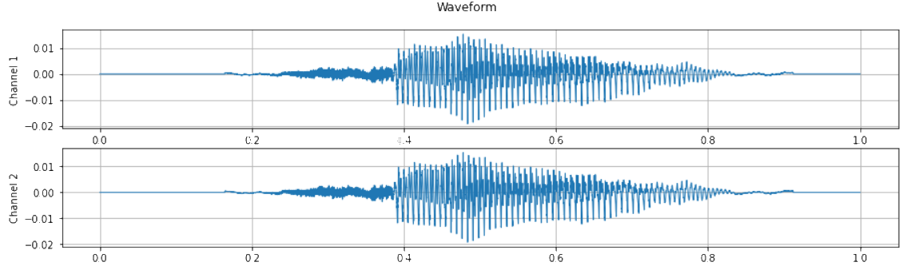
Sound Utils – Audio preprocessing (2)
File audio
Open
Rechannel (2 channels)
Resample (48 kHz)
Pad or trunc (pad 1 sec)

Slide 7
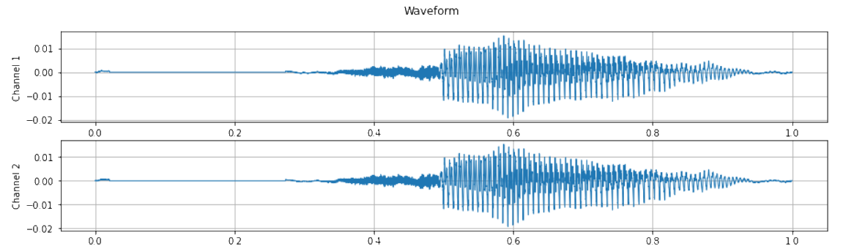
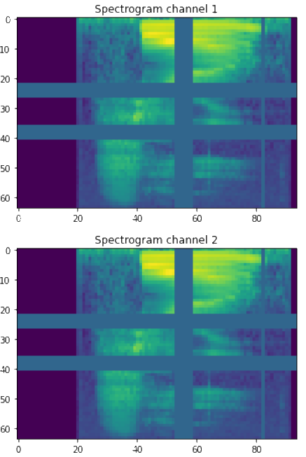
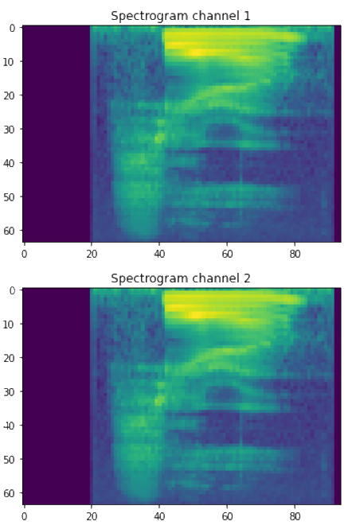
Sound Utils – Audio preprocessing (3)
Time shift (right 20%)
Data augmentation (freq mask 2 & time mask 2)
Spectrogram

Slide 8
Digits speach model – Dataset + Dataloader
0_01_0.wav
0_01_1.wav
01
0_01_49.wav
class DigitsSoundDataset(Dataset):
def __init__(self, data_path, num_folders, num_sounds)…
def __len__(self)…
def __getitem__(self, idx)…
dataset = DigitsSoundDataset("gdrive/My Drive/Colab Notebooks/RECORDINGS/", 60, 30000) num_train = 80% num_test = 20% training_set, test_set = random_split(dataset, [num_train, num_test])
train_dataloader = torch.utils.data.DataLoader(training_set, batch_size=40, shuffle=True) test_dataloader = torch.utils.data.DataLoader(test_set, batch_size=40, shuffle=False)
1_01_0.wav
RECORDINGS
60
1_01_49.wav
TestSet
20%
9_01_49.wav
DS
TS – 80%
0_60_1.wav
9_60_49.wav

Slide 9
Digits speach model – CNN
class SoundCNN(nn.Module): def __init__(self): super().__init__() conv_layers = [] self.conv1 = nn.Conv2d(2, 8, kernel_size=(5, 5), stride=(2, 2), padding=(2, 2)) self.relu1 = nn.ReLU() self.bn1 = nn.BatchNorm2d(8) init.kaiming_normal_(self.conv1.weight, a=0.1) self.conv1.bias.data.zero_() conv_layers += [self.conv1, self.relu1, self.bn1] self.conv2 = nn.Conv2d(8, 16, kernel_size=(3, 3), stride=(2, 2), padding=(1, 1)) self.relu2 = nn.ReLU() self.bn2 = nn.BatchNorm2d(16) init.kaiming_normal_(self.conv2.weight, a=0.1) self.conv2.bias.data.zero_() conv_layers += [self.conv2, self.relu2, self.bn2] self.conv3 = nn.Conv2d(16, 32, kernel_size=(3, 3), stride=(2, 2), padding=(1, 1)) self.relu3 = nn.ReLU() self.bn3 = nn.BatchNorm2d(32) init.kaiming_normal_(self.conv3.weight, a=0.1) self.conv3.bias.data.zero_() conv_layers += [self.conv3, self.relu3, self.bn3] self.conv4 = nn.Conv2d(32, 64, kernel_size=(3, 3), stride=(2, 2), padding=(1, 1)) self.relu4 = nn.ReLU() self.bn4 = nn.BatchNorm2d(64) init.kaiming_normal_(self.conv4.weight, a=0.1) self.conv4.bias.data.zero_() conv_layers += [self.conv4, self.relu4, self.bn4] self.ap = nn.AdaptiveAvgPool2d(output_size=1) self.lin = nn.Linear(in_features=64, out_features=10) self.conv = nn.Sequential(*conv_layers)
def forward(self, x): x = self.conv(x) x = self.ap(x) x = x.view(x.shape[0], -1) x = self.lin(x) return x

Slide 10
Digits speach model – Training Network

